Slide 1
Modelling climate change impacts on agricultural production using deep learning
Lei Gao, Yichang Gao, Yun Chen, and Javier Navarro Garcia
The 25th International Congress on Modelling and Simulation, 13th July, 2023

Slide 2
Agenda
Motivation
Methods for
Generation of grid-level agricultural yield data
Deep learning models with convolutional structures
Results: model performance
Conclusions and future work

Slide 3
Impacts of climate change on Australian agriculture
Changes in climate have reduced Australian wheat yields by ~27% since 1990
There remains needs for improved understanding about climate change impacts on Australian agriculture over the long term
Impact models are required to estimate the future effects of climate change on agricultural production in Australia
Estimates of climate change impacts on agriculture are important both in informing local adaptation responses and as an input to global assessments of agricultural supply and demand under climate change

Slide 4
Impact models
Process-based models/crop growth models, such as Agricultural Production System sIMulator (APSIM)
Studies published prior to 31 December 2019
Often have limited spatial and industry coverage, with studies usually focusing on a small number of representative farm businesses/locations
(Darbyshire et al., 2022)

Slide 5
Impact models
Deep learning
A valuable complement
Particularly suitable for capturing intricate, nonlinear relationships among climate variables, agricultural practices, and crop yields
Scalable, enabling their applications to a broader spatial scope and a wider range of agricultural systems
Data driven and able to integrate different sources of big data
Evidence of machine learning outperforming simple impact models in agriculture

Slide 6
Case study area
Significance of basin’s agriculture
Supports 9,200 irrigated agriculture businesses
Produces $24 billion worth of food and fibre every year
40% of all Australian farms
Accounts for almost 40% by value of Australia’s agricultural production
Wheat yield
A key region for wheat production, accounting for almost half (48%) of all wheat produced in Australia
Murray-Darling Basin

Slide 7
Agricultural data for modelling
No data on the spatial distribution of farmers sowing vs not sowing, or on farm-level yields (Still trying to get access to some point data from ABS+ABARES)
Yield estimation: Use of official statistics and combination with RS for yield distribution

Slide 8
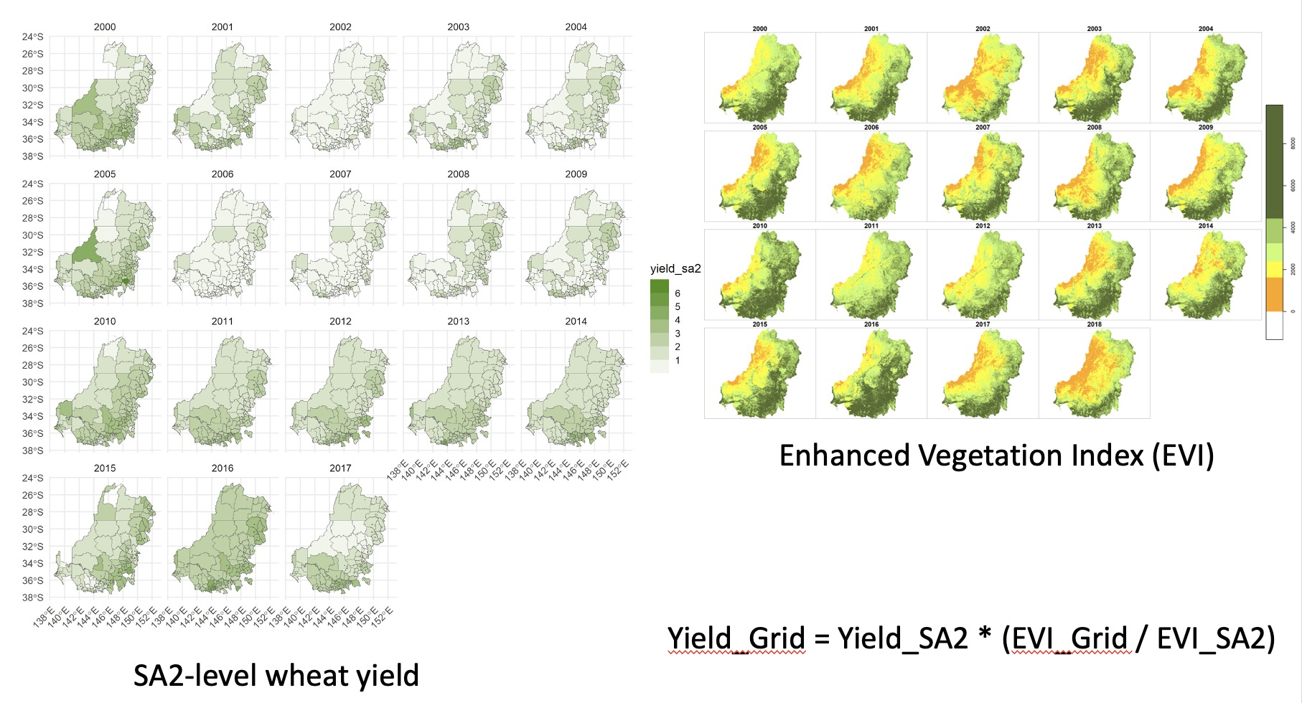
Generation of grid-level agricultural yield: wheat yield as an example

Slide 9
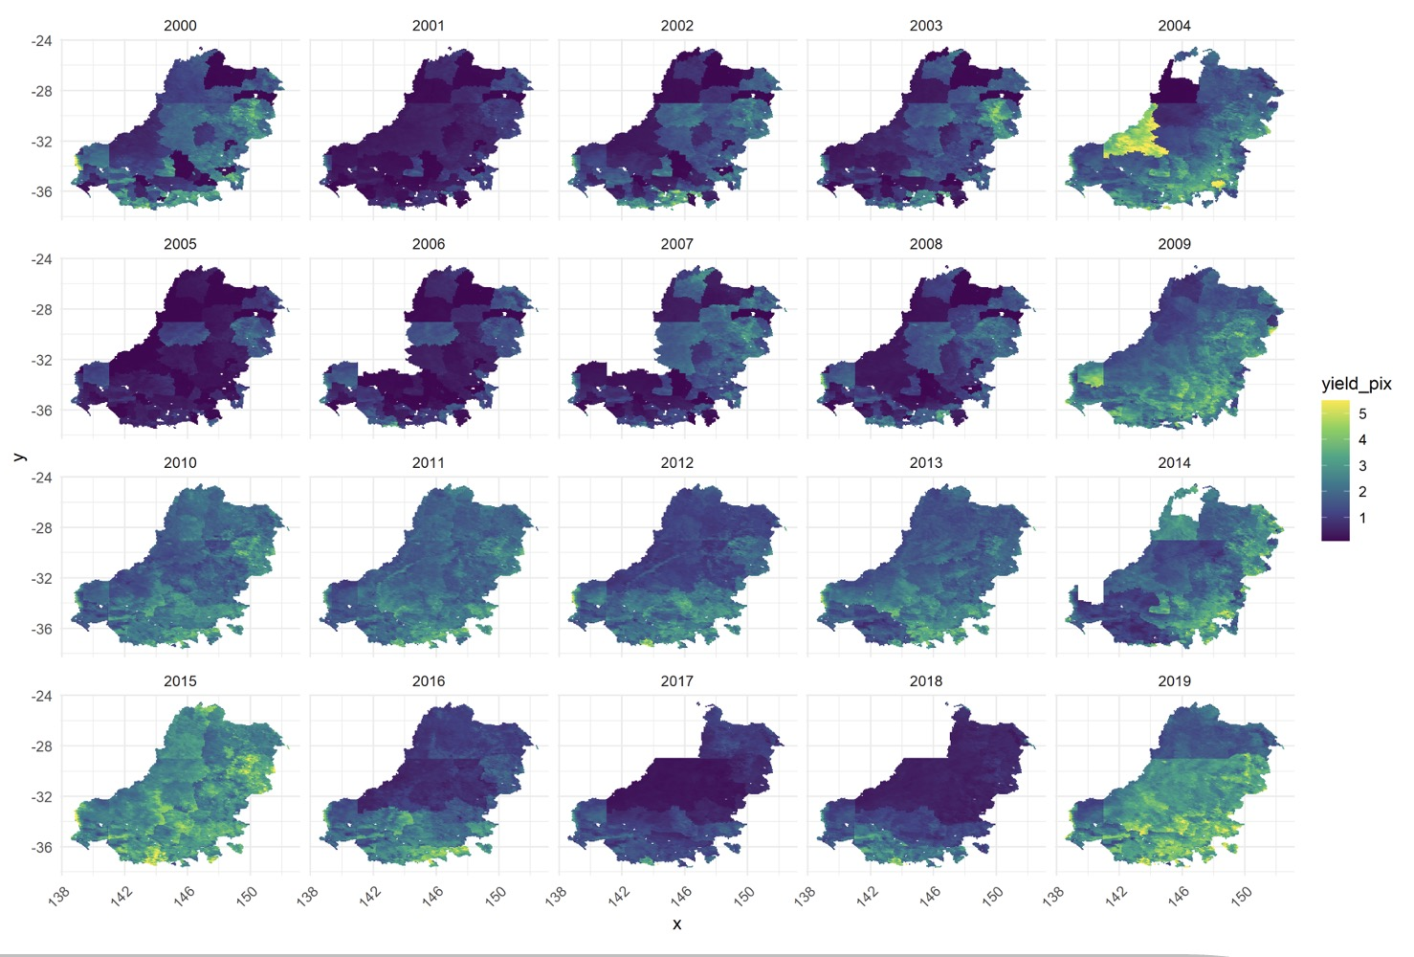
Generation of grid-level agricultural yield: wheat yield as an example

Slide 10
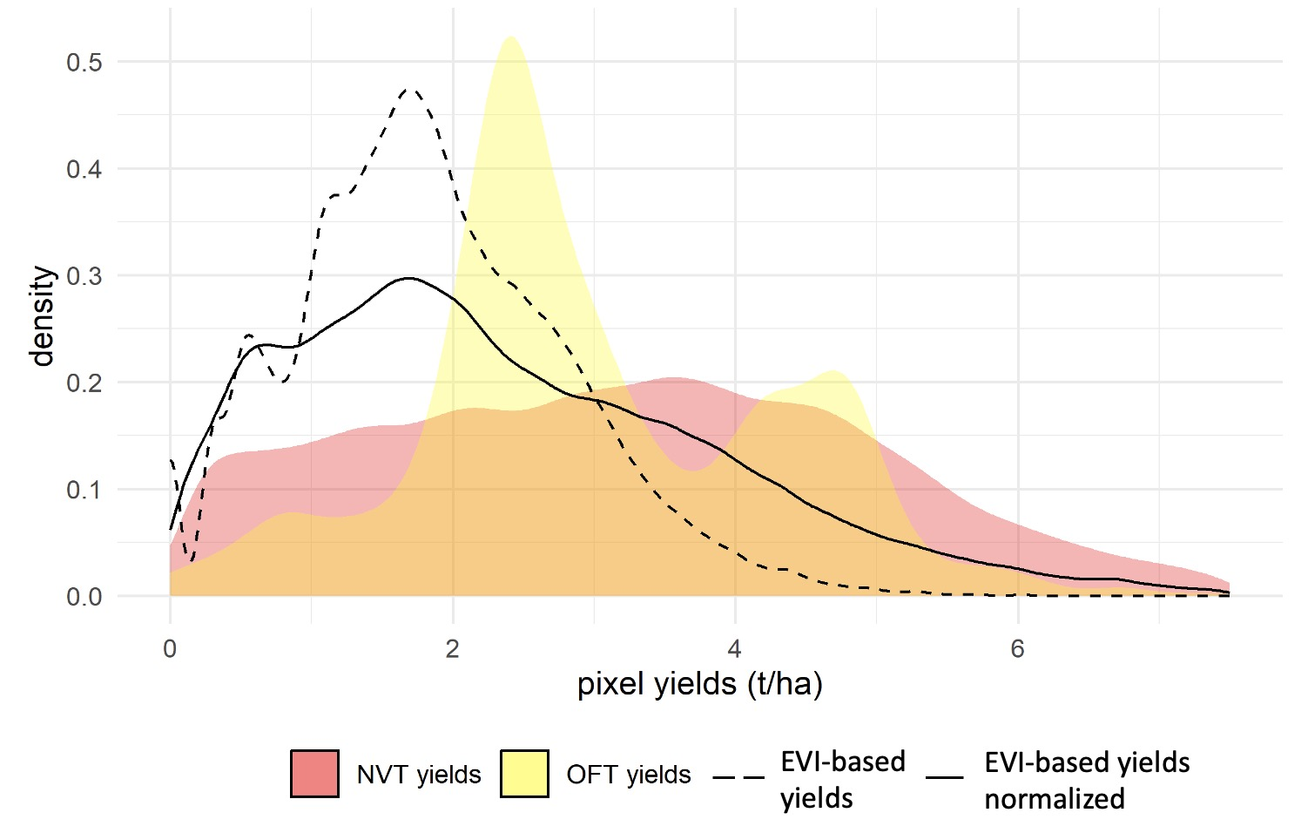
Generation of grid-level agricultural yield: Comparison with long-term data from the Grains Research and Development Corporation’s (GRDC’s) National Variety Trials (NVT) and the Online Farm Trials (OFT)

Slide 11
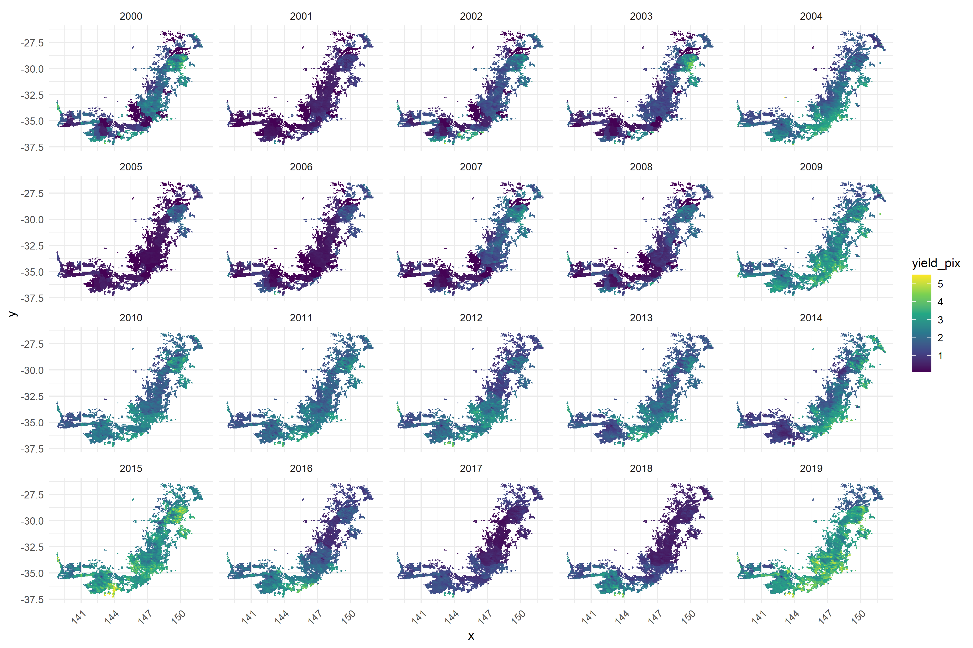
Modelling spatiotemporal climate impacts on wheat yield in the MDB at the grid level
Target variable: 20 years’ wheat yields from 2000 to 2019
Explanatory variables/covariates
Time series from 2000 to 2019: annual, April–October, and June–August rainfall, maximum temperature, minimum temperature, actual evapotranspiration, and radiation (3*5 = 15 time-series variables)
Static variables: average aridity index, average clay depth, average silt depth, average sand depth, regolith depth, and weathering intensity index (6 variables)
MDB cropping zone is selected, where there is minimal signal interference and wheat production is prevalent: 10,955 0.05*0.05 degree grids
Data from 2000 to 2015 (16 years, 80%) as the training dataset and data from 2016 to 2019 (4 years, 20%) as the test dataset

Slide 12
Modelling spatiotemporal climate impacts on wheat yield in the MDB at the grid level
Developed a ConvLSTM/CNNLSTM/ConvGRU model to project both temporal and spatial changes in wheat yields
Long Short-Term Memory (LSTM) and Gated Recurrent Unit (GRU) are two types of recurrent neural network architectures, effectively extracting the temporal characteristics of time series
The ConvLSTM/CNNLSTM/ConvGRU model includes a convolutional neural network and a recurrent neural network for extracting the spatiotemporal characteristics of wheat yield changes
The model captures basic spatial features by performing convolution operations in multidimensional data and replaces the matrix multiplication step with the convolution operation of each gate in the LSTM unit

Slide 13
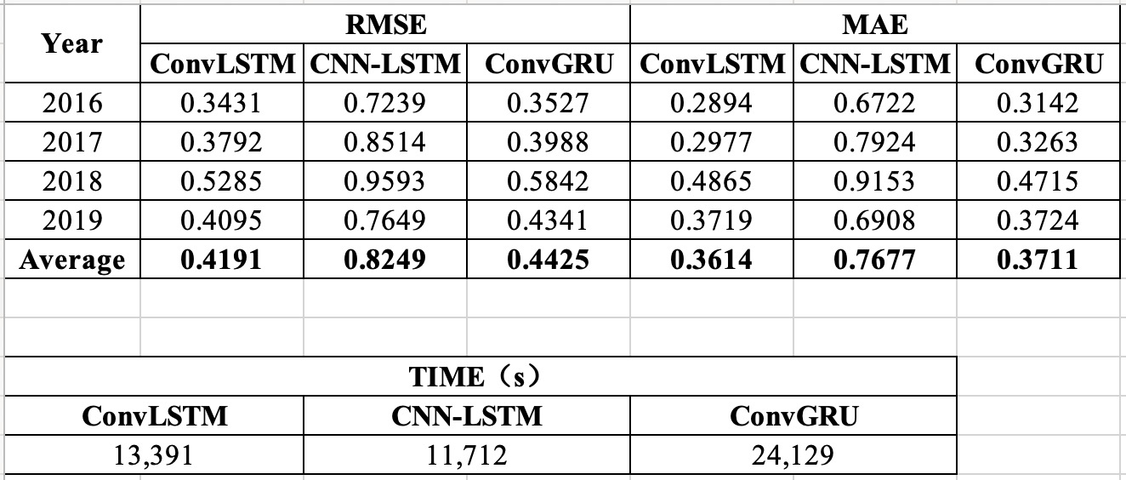
Modelling spatiotemporal climate impacts on wheat yield: Performance

Slide 14
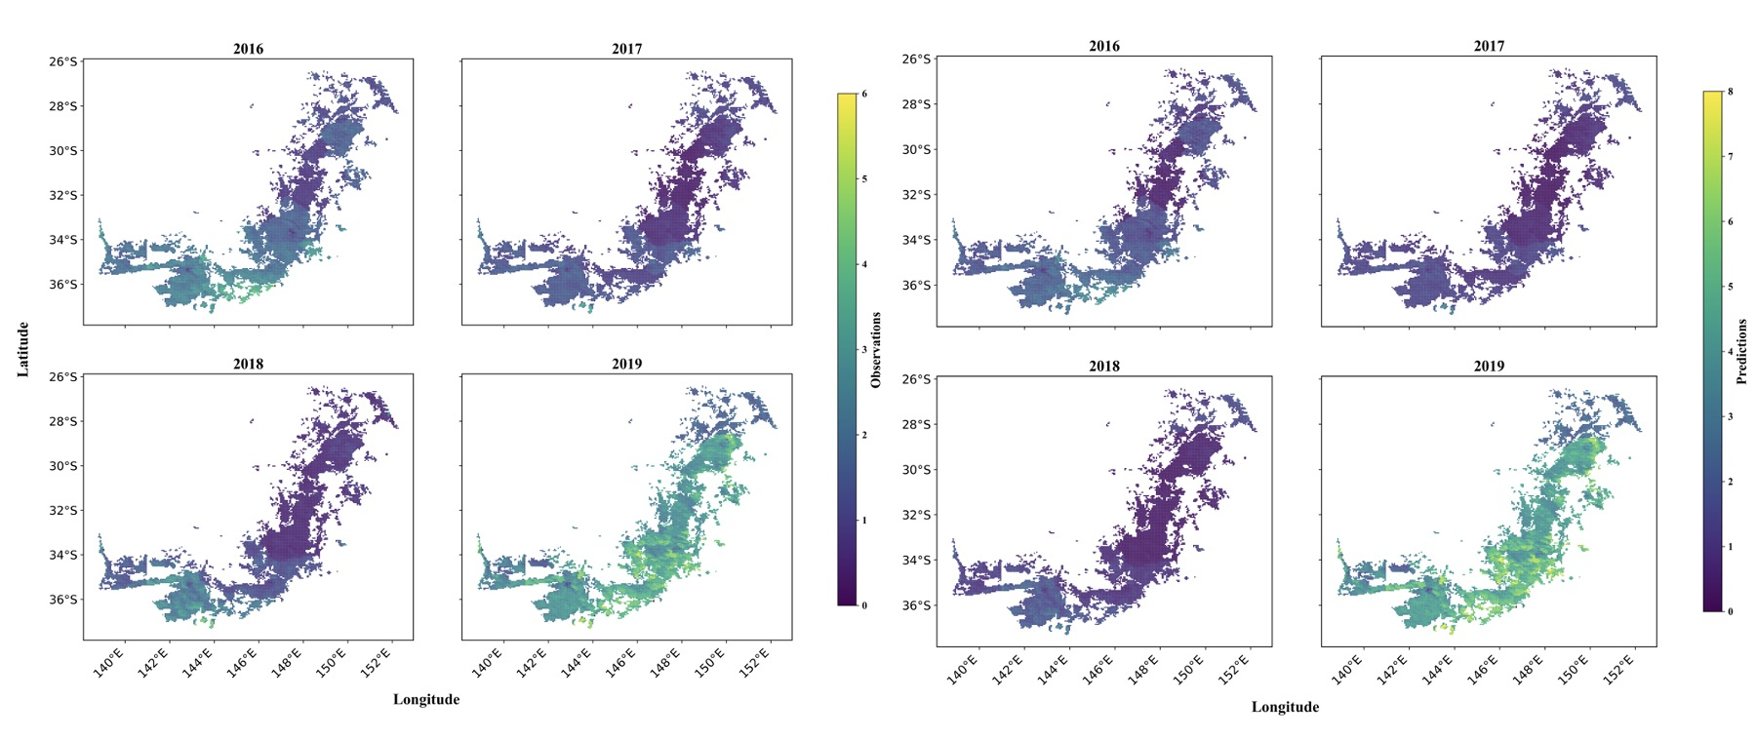
Modelling spatiotemporal climate impacts on wheat yield: Performance (Observations vs. Predictions)
Observed/produced wheat yields (Normalized EVI-based yields) using RS and ABS statistics
Predicted wheat yields by the convLSTM model

Slide 15
Modelling spatiotemporal climate impacts on wheat yield: Performance (Differences = Predictions – Observations)

Slide 16
Conclusion and future work
Conclusion
Produced grid-level yield data
Built three deep learning models with convolutional structures
These models can capture intricate, nonlinear relationships between climate variables and crop yields
Such models are scalable, enabling their applications to a broader spatial scope and a wider range of agricultural systems
Limitations
May overestimate the impacts of climate change
Black boxes, lack of interpretability in the underlying mechanisms
Next steps
Enhance interpretability: Identify influential factors in predicting wheat yields
Use the developed models to predict future yields given climate projections (Climate Change in Australia)
Identify risky areas under particular climate patterns and develop adaptation strategies to reduce the risks

